Slide 1
Chapter 3 - Introduction to Java Applets
Outline
3.1 Introduction
3.2 Sample Applets from the Java 2 Software Development Kit
3.2.1 The TicTacToe Applet
3.2.2 The DrawTest Applet
3.2.3 The Java2D Applet
3.3 A Simple Java Applet: Drawing a String
3.3.1 Compiling and Executing WelcomeApplet
3.4 Two More Simple Applets: Drawing Strings and Lines
3.5 Another Java Applet: Adding Floating-Point Numbers
3.6 Viewing Applets in a Web Browser
3.6.1 Viewing Applets in Netscape Navigator 6
3.6.2 Viewing Applets in Other Browsers Using the Java Plug-In
3.7 Java Applet Internet and World Wide Web Resources
3.8 (Optional Case Study) Thinking About Objects: Identifying the Classes in a Problem Statement

Slide 2
3.1 Introduction
Applet
  Program that runs in
    appletviewer (test utility for applets)
    Web browser (IE, Communicator)
  Executes when HTML (Hypertext Markup Language) document containing applet is opened and downloaded
  Applications run in command windows
Notes
  Mimic several features of Chapter 2 to reinforce them
  Focus on fundamental programming concepts first
    Explanations will come later

Slide 3
3.2 Sample Applets from the Java 2 Software Development Kit
Sample Applets
  Provided in Java 2 Software Development Kit (J2SDK)
  Source code included (.java files)
    Study and mimic source code to learn new features
    All programmers begin by mimicking existing programs
  Located in demo directory of J2SDK install
  Can download demos and J2SDK from
  java.sun.com/products/jdk/1.3/

Slide 4
3.2.1 The TicTacToe Applet
Running applets
  In command prompt, change to demo subdirectory of applet
  cd c:\jdk1.3\demo\applets
  cd appletDirectoryName
  There will be an HTML file used to execute applet
  Type appletviewer example1.html
    appletviewer loads the html file specified as its command-line argument
    From the HTML file, determines which applet to load (more section 3.3)
  Applet will run, Reload and Quit commands under Applet menu

Slide 5
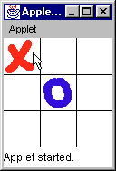
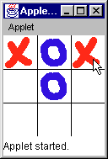
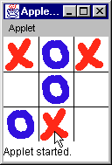
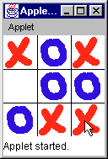
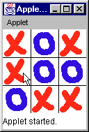
3.2.1 The TicTacToe Applet
You start as player "X"
Fig. 3.2 Sample execution of the TicTacToe applet.

Slide 6
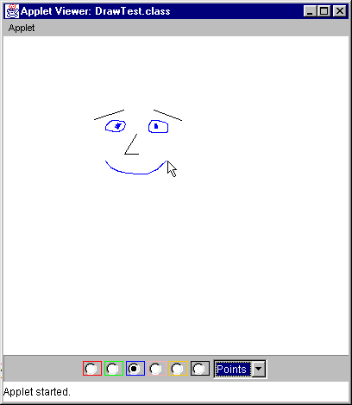
3.2.2 The DrawTest Applet
Fig. 3.4 Sample execution of applet DrawTest.

Slide 7
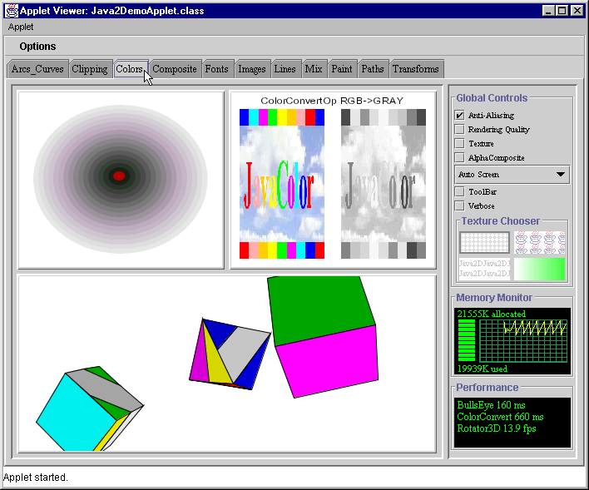
3.2.3 The Java2D Applet
Demonstrates 2D drawing capabilities built into Java2

Slide 8
3.3 A Simple Java Applet: Drawing a String
Now, create applets of our own
  Take a while before we can write applets like in the demos
  Cover many of same techniques
Upcoming program
  Create an applet to display
  "Welcome to Java Programming!"
  Show applet and HTML file, then discuss them line by line

Slide 9
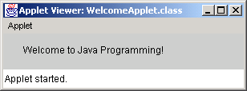
Java applet
Program Output
1 // Fig. 3.6: WelcomeApplet.java
2 // A first applet in Java.
3
4 // Java core packages
5 import java.awt.Graphics; // import class Graphics
6
7 // Java extension packages
8 import javax.swing.JApplet; // import class JApplet
9
10 public class WelcomeApplet extends JApplet {
11
12 // draw text on applet’s background
13 public void paint( Graphics g )
14 {
15 // call inherited version of method paint
16 super.paint( g );
17
18 // draw a String at x-coordinate 25 and y-coordinate 25
19 g.drawString( "Welcome to Java Programming!", 25, 25 );
20
21 } // end method paint
22
23 } // end class WelcomeApplet
import allows us to use predefined classes (allowing us to use applets and graphics, in this case).
extends allows us to inherit the capabilities of class JApplet.
Method paint is guaranteed to be called in all applets. Its first line must be defined as above.

Slide 10
3.3 A Simple Java Applet: Drawing a String
// Fig. 3.6: WelcomeApplet.java
2 // A first applet in Java.
  Comments
    Name of source code and description of applet
  Import predefined classes grouped into packages
    import statements tell compiler where to locate classes used
    When you create applets, import the JApplet class (package javax.swing)
    import the Graphics class (package java.awt) to draw graphics
      Can draw lines, rectangles ovals, strings of characters
    import specifies directory structure
5 import java.awt.Graphics; // import class Graphics
8 import javax.swing.JApplet; // import class JApplet

Slide 11
3.3 A Simple Java Applet: Drawing a String
  Applets have at least one class definition (like applications)
    Rarely create classes from scratch
      Use pieces of existing class definitions
      Inheritance - create new classes from old ones (ch. 15)
  Begins class definition for class WelcomeApplet
    Keyword class then class name
  extends followed by class name
    Indicates class to inherit from (JApplet)
      JApplet : superclass (base class)
      WelcomeApplet : subclass (derived class)
    WelcomeApplet now has methods and data of JApplet
10 public class WelcomeApplet extends JApplet {

Slide 12
3.3 A Simple Java Applet: Drawing a String
  Class JApplet defined for us
    Someone else defined "what it means to be an applet"
      Applets require over 200 methods!
    extends JApplet
      Inherit methods, do not have to define them all
    Do not need to know every detail of class JApplet
10 public class WelcomeApplet extends JApplet {

Slide 13
3.3 A Simple Java Applet: Drawing a String
  Class WelcomeApplet is a blueprint
    appletviewer or browser creates an object of class WelcomeApplet
      Keyword public required
      File can only have one public class
      public class name must be file name
10 public class WelcomeApplet extends JApplet {

Slide 14
3.3 A Simple Java Applet: Drawing a String
  Our class inherits method paint from JApplet
    By default, paint has empty body
    Override (redefine) paint in our class
  Methods paint, init, and start
    Guaranteed to be called automatically
    Our applet gets "free" version of these by inheriting from JApplet
      Free versions have empty body (do nothing)
      Every applet does not need all three methods
        Override the ones you need
  Applet container “draws itself” by calling method paint
13 public void paint( Graphics g )

Slide 15
3.3 A Simple Java Applet: Drawing a String
  Method paint
    Lines 13-21 are the definition of paint
    Draws graphics on screen
    void indicates paint returns nothing when finishes task
    Parenthesis define parameter list - where methods receive data to perform tasks
      Normally, data passed by programmer, as in JOptionPane.showMessageDialog
    paint gets parameters automatically
      Graphics object used by paint
    Mimic paint's first line
13 public void paint( Graphics g )

Slide 16
3.3 A Simple Java Applet: Drawing a String
16 super.paint( g );
  Calls version of method paint from superclass JApplet
  Should be first statement in every applet’s paint method
  Body of paint
    Method drawString (of class Graphics)
    Called using Graphics object g and dot operator (.)
    Method name, then parenthesis with arguments
      First argument: String to draw
      Second: x coordinate (in pixels) location
      Third: y coordinate (in pixels) location
  Java coordinate system
    Measured in pixels (picture elements)
    Upper left is (0,0)
19 g.drawString( "Welcome to Java Programming!", 25, 25 );

Slide 17
3.3.1 Compiling and Executing WelcomeApplet
Running the applet
  Compile
    javac WelcomeApplet.java
    If no errors, bytecodes stored in WelcomeApplet.class
  Create an HTML file
    Loads the applet into appletviewer or a browser
    Ends in .htm or .html
  To execute an applet
    Create an HTML file indicating which applet the browser (or appletviewer) should load and execute

Slide 18
3.3.1 Compiling and Executing WelcomeApplet
  Simple HTML file (WelcomeApplet.html)
    Usually in same directory as .class file
    Remember, .class file created after compilation
  HTML codes (tags)
    Usually come in pairs
    Begin with < and end with >
  Lines 1 and 4 - begin and end the HTML tags
  Line 2 - begins <applet> tag
    Specifies code to use for applet
    Specifies width and height of display area in pixels
  Line 3 - ends <applet> tag
1 <html>
2 <applet code = "WelcomeLines.class" width = "300" height = "40">
3 </applet>
4 </html>

Slide 19
3.3.1 Compiling and Executing WelcomeApplet
  appletviewer only understands <applet> tags
    Ignores everything else
    Minimal browser
  Executing the applet
    appletviewer WelcomeApplet.html
    Perform in directory containing .class file
1 <html>
2 <applet code = "WelcomeLines.class" width = "300" height = "40">
3 </applet>
4 </html>

Slide 20
3.4 Two More Simple Applets: Drawing Strings and Lines
More applets
  First example
    Display two lines of text
    Use drawString to simulate a new line with two drawString statements
  Second example
    Method g.drawLine(x1, y1, x2, y2 )
      Draws a line from (x1, y1) to (x2, y2)
      Remember that (0, 0) is upper left
    Use drawLine to draw a line beneath and above a string

Slide 21
1. import
2. Class WelcomeApplet2 (extends JApplet)
3. paint
3.1 drawString
3.2 drawString on same x coordinate, but 15 pixels down
1 // Fig. 3.8: WelcomeApplet2.java
2 // Displaying multiple strings in an applet.
3
4 // Java core packages
5 import java.awt.Graphics; // import class Graphics
6
7 // Java extension packages
8 import javax.swing.JApplet; // import class JApplet
9
10 public class WelcomeApplet2 extends JApplet {
11
12 // draw text on applet’s background
13 public void paint( Graphics g )
14 {
15 // call inherited version of method paint
16 super.paint( g );
17
18 // draw two Strings at different locations
19 g.drawString( "Welcome to", 25, 25 );
20 g.drawString( "Java Programming!", 25, 40 );
21
22 } // end method paint
23
24 } // end class WelcomeApplet2
The two drawString statements simulate a newline. In fact, the concept of lines of text does not exist when drawing strings.

Slide 22
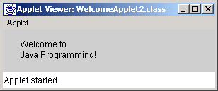
HTML file
Program Output
1 <html>
2 <applet code = "WelcomeApplet2.class" width = "300" height = "60">
3 </applet>
4 </html>

Slide 23
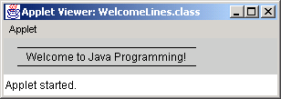
WelcomeLines.java
2. Class WelcomeLines (extends JApplet)
3. paint
3.1 drawLine
3.2 drawLine
3.3 drawString
Program Output
1 // Fig. 3.10: WelcomeLines.java
2 // Displaying text and lines
3
4 // Java core packages
5 import java.awt.Graphics; // import class Graphics
6
7 // Java extension packages
8 import javax.swing.JApplet; // import class JApplet
9
10 public class WelcomeLines extends JApplet {
11
12 // draw lines and a string on applet’s background
13 public void paint( Graphics g )
14 {
15 // call inherited version of method paint
16 super.paint( g );
17
18 // draw horizontal line from (15, 10) to (210, 10)
19 g.drawLine( 15, 10, 210, 10 );
20
21 // draw horizontal line from (15, 30) to (210, 30)
22 g.drawLine( 15, 30, 210, 30 );
23
24 // draw String between lines at location (25, 25)
25 g.drawString( "Welcome to Java Programming!", 25, 25 );
26
27 } // end method paint
28
29 } // end class WelcomeLines
Draw horizontal lines with drawLine (endpoints have same y coordinate).

Slide 24
HTML file
1 <html>
2 <applet code = "WelcomeLines.class" width = "300" height = "40">
3 </applet>
4 </html>

Slide 25
3.4 Two More Simple Applets: Drawing Strings and Lines
Method drawLine of class Graphics
  Takes as arguments Graphics object and line’s end points
  X and y coordinate of first endpoint
  X and y coordinate of second endpoint

Slide 26
3.5 Another Java Applet: Adding Floating-Point Numbers
Next applet
  Mimics application for adding two integers (Fig 2.9)
    This time, use floating point numbers (numbers with a decimal point)
      Using primitive data types
        Double – double precision floating-point numbers
        Float – single precision floating-point numbers
  Show program, then discuss

Slide 27
AdditionApplet.java
1. import
2. Class AdditionApplet (extends JApplet)
3. Instance variable
4. init
4.1 Declare variables
4.2 showInputDialog
4.3 parseDouble
1 // Fig. 3.12: AdditionApplet.java
2 // Adding two floating-point numbers.
3
4 // Java core packages
5 import java.awt.Graphics; // import class Graphics
6
7 // Java extension packages
8 import javax.swing.*; // import package javax.swing
9
10 public class AdditionApplet extends JApplet {
11 double sum; // sum of values entered by user
12
13 // initialize applet by obtaining values from user
14 public void init()
15 {
16 String firstNumber; // first string entered by user
17 String secondNumber; // second string entered by user
18 double number1; // first number to add
19 double number2; // second number to add
20
21 // obtain first number from user
22 firstNumber = JOptionPane.showInputDialog(
23 "Enter first floating-point value" );
24
25 // obtain second number from user
26 secondNumber = JOptionPane.showInputDialog(
27 "Enter second floating-point value" );
28
29 // convert numbers from type String to type double
30 number1 = Double.parseDouble( firstNumber );
31 number2 = Double.parseDouble( secondNumber );
32
2 // Adding two floating-point numbers
3 import java.awt.Graphics; // import class Graphics
5
6 public class AdditionApplet extends JApplet {
7 double sum; // sum of the values entered by the user
8
9 public void init()
10 {
* allows any class in the the package to be used.
11 String firstNumber, // first string entered by user
12 secondNumber; // second string entered by user
13 double number1, // first number to add
14 number2; // second number to add
15
16 // read in first number from user
Instance variable sum may be used anywhere in the class, even in other methods.
Data type double can store floating point numbers.
17 firstNumber =
18 JOptionPane.showInputDialog(
19 "Enter first floating-point value" );
20
21 // read in second number from user
22 secondNumber =
23 JOptionPane.showInputDialog(
24 "Enter second floating-point value" );
25
26
27 // convert numbers from type String to type double

Slide 28
5. Draw applet contents
5.1 Draw a rectangle
5.2 Draw the results
HTML file
33 // add numbers
34 sum = number1 + number2;
35 }
36
37 // draw results in a rectangle on applet’s background
38 public void paint( Graphics g )
39 {
40 // call inherited version of method paint
41 super.paint( g );
42
43 // draw rectangle starting from (15, 10) that is 270
44 // pixels wide and 20 pixels tall
45 g.drawRect( 15, 10, 270, 20 );
46
47 // draw results as a String at (25, 25)
48 g.drawString( "The sum is " + sum, 25, 25 );
49
50 } // end method paint
51
52 } // end class AdditionApplet
31 // add the numbers
32 sum = number1 + number2;
33 }
34
35 public void paint( Graphics g )
36 {
37 // draw the results with g.drawString
38 g.drawRect( 15, 10, 270, 20 );
39 g.drawString( "The sum is " + sum, 25, 25 );
40 }
41 }
1 <html>
2 <applet code="AdditionApplet.class" width=300 height=50>
3 </applet>
drawRect takes the upper left coordinate, width, and height of the rectangle to draw.
4 </html>
1 <html>
2 <applet code = "WelcomeLines.class" width = "300" height = "40">
3 </applet>
4 </html>

Slide 29
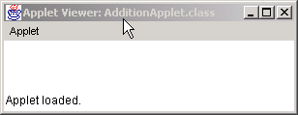
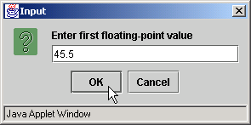
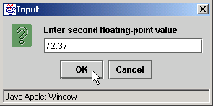
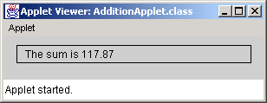
Program Output

Slide 30
3.5 Another Java Applet: Adding Floating-Point Numbers
  Lines 1-2: Comments
  Line 5: imports class Graphics
    import not needed if use full package and class name
    public void paint ( java.awt.Graphics g )
  Line 8: specify entire javax.swing package
    * indicates all classes in javax.swing are available
      Includes JApplet and JOptionPane
      Use JOptionPane instead of javax.swing.JOptionPane
    * does not not load all classes
      Compiler only loads classes it uses
5 import java.awt.Graphics;
8 import javax.swing.*;

Slide 31
3.5 Another Java Applet: Adding Floating-Point Numbers
  Begin class definition
    Inherit from JApplet, imported from package javax.swing
  Instance variable declaration
    Each object of class gets own copy of the instance variable
    Declared in body of class, but not inside methods
      Variables declared in methods are local variables
      Can only be used in body of method
    Instance variables can be used anywhere in class
    Have default value (0.0 in this case)
10 public class AdditionApplet extends JApplet {
11 double sum; // sum of values entered by user

Slide 32
3.5 Another Java Applet: Adding Floating-Point Numbers
  Primitive data type double
    Used to store floating point (decimal) numbers
  Method init
    Normally initializes instance variables and applet class
    Guaranteed to be first method called in applet
    First line must always appear as above
      Returns nothing (void), takes no arguments
  Begins body of method init
11 double sum; // sum of values entered by user
14 public void init()
15 {

Slide 33
3.5 Another Java Applet: Adding Floating-Point Numbers
  Declare variables
  Two types of variables
    Reference variables (called references)
      Refer to objects (contain location in memory)
        Objects defined in a class definition
        Can contain multiple data and methods
      paint receives a reference called g to a Graphics object
      Reference used to call methods on the Graphics object
    Primitive data types (called variables)
      Contain one piece of data
16 String firstNumber; // first string entered by user
17 String secondNumber; // second string entered by user
18 double number1; // first number to add
19 double number2; // second number to add

Slide 34
3.5 Another Java Applet: Adding Floating-Point Numbers
16 String firstNumber; // first string entered by user
17 String secondNumber; // second string entered by user
18 double number1; // first number to add
19 double number2; // second number to add
  Distinguishing references and variables
    If data type is a class name, then reference
      String is a class
      firstNumber, secondNumber
    If data type a primitive type, then variable
      double is a primitive data type
      number1, number2

Slide 35
3.5 Another Java Applet: Adding Floating-Point Numbers
22 firstNumber = JOptionPane.showInputDialog(
23 "Enter first floating-point value" );
Method JOptionPane.showInputDialog
    Prompts user for input with string
    Enter value in text field, click OK
      If not of correct type, error occurs
      In Chapter 14 learn how to deal with this
    Returns string user inputs
    Assignment statement to string
  Lines 26-27: As above, assigns input to secondNumber

Slide 36
3.5 Another Java Applet: Adding Floating-Point Numbers
30 number1 = Double.parseDouble( firstNumber );
31 number2 = Double.parseDouble( secondNumber );
  static method Double.parseDouble
    Converts String argument to a double
    Returns the double value
    Remember static method syntax
      ClassName.methodName( arguments )
  Assignment statement
    sum an instance variable, can use anywhere in class
      Not defined in init but still used
34 sum = number1 + number2;

Slide 37
3.5 Another Java Applet: Adding Floating-Point Numbers
  Ends method init
    appletviewer (or browser) calls inherited method start
    start usually used with multithreading
      Advanced concept, in Chapter 15
      We do not define it, so empty definition in JApplet used
    Next, method paint called
  Method drawRect( x1, y1, width, height )
    Draw rectangle, upper left corner (x1, y1), specified width and height
    Line 45 draws rectangle starting at (15, 10) with a width of 270 pixels and a height of 20 pixels
33 }
45 g.drawRect( 15, 10, 270, 20 );

Slide 38
3.5 Another Java Applet: Adding Floating-Point Numbers
  Sends drawString message (calls method) to Graphics object using reference g
    "The sum is" + sum - string concatenation
      sum converted to a string
    sum can be used, even though not defined in paint
      Instance variable, can be used anywhere in class
      Non-local variable
48 g.drawString( "The sum is " + sum, 25, 25 );

Slide 39
3.6 Viewing Applets in a Web Browser
Applets can execute on Java-enabled browsers
  Many different browser version supporting different Java version specifications
    Some support for Java 1.0, many for Java 1.1 inconsistently
  Netscape Navigator 6 supports Java 2 (section 3.6.1)
  Use Java Plug-in to execute Java 2 applets on other browsers (section 3.6.2)

Slide 40
3.6.1 Viewing Applets in Netscape Navigator 6
Netscape Navigator 6 supports Java 2
  Default installation component
  able to load applet HTML into browser and execute applet
  Download browser at www.netscape.com
  After installing, open applet HTML file using Open File… menu item in File menu

Slide 41
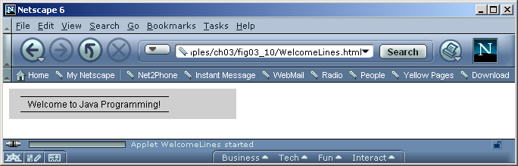
3.6.1 Viewing Applets in Netscape Navigator 6
Fig. 3.14 Applet of Fig. 3.10 executing in Netscape Navigator 6.
applet’s upper-left corner
HTML file loaded into browser
status bar

Slide 42
3.6.2 Viewing Applets in Other Browsers Using the Java Plug-In
Java Plug-in support from Sun
  Uses Java 2 Runtime Environment (J2RE)
    Can be downloaded and installed dynamically
  Applet HTML file must indicate use of Java Plug-in
    Convert <applet> and </applet> tags to plug-in-loading tags
    Sun provides Java Plug-in 1.3 HTML Converter for conversion
      Download and info at java.sun.com/products/plugin
      Executable in classes subdirectory of converter directory
        Batch file HTMLConverter.bat on Windows
        HTML Converter.sh shell script for Linux/UNIX

Slide 43
3.6.2 Viewing Applets in Other Browsers Using the Java Plug-In
Java Plug-in HTML Converter process
  Select directory containing HTML files to convert
    Click Browse button in Converter to open file chooser to select directory
    Or type in the directory
  Select conversion template to support browsers
    Defaults: Netscape Navigator and Microsoft Internet Explorer
    Use Template File drop-down list
  Click Convert… button to convert
    Might need to download J2RE if not installed
    After conversion, progress and status window pops up
    Able to use applet HTML in supported browser
  (see pictorial figures)

Slide 44
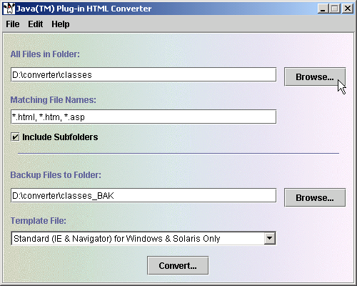
3.6.2 Viewing Applets in Other Browsers Using the Java Plug-In
Fig. 3.15 Java Plug-in HTML Converter window.

Slide 45
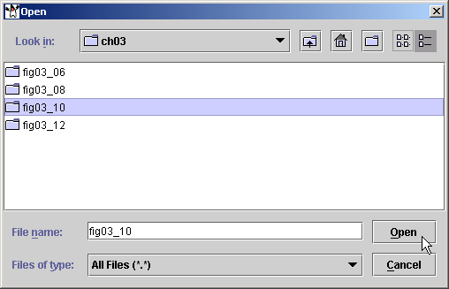
3.6.2 Viewing Applets in Other Browsers Using the Java Plug-In
Fig. 3.16 Selecting the directory containing HTML files to convert.

Slide 46
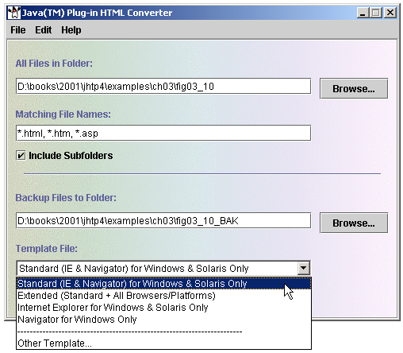
3.6.2 Viewing Applets in Other Browsers Using the Java Plug-In
Fig. 3.17 Selecting the template used to convert the HTML files.

Slide 47
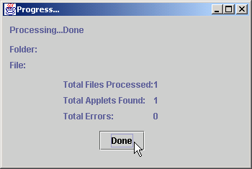
3.6.2 Viewing Applets in Other Browsers Using the Java Plug-In
Fig. 3.18 Confirmation dialog after conversion completes

Slide 48
3.7 Java Applet Internet and World Wide Web Resources
Many Java applet resources available
  java.sun.com/applets/
  Many resources and free applets
    Has demo applets from J2SDK
  Sun site developer.java.sun.com/developer
    Tech support, discussion forums, training, articles, links, etc.
    Registration required
  www.jars.com
    Rates applets, top 1, 5 and 25 percent
    View best applets on web

Slide 49
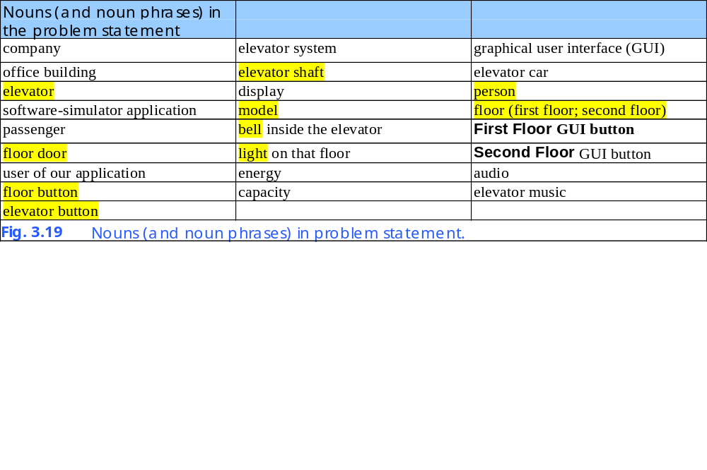
3.8 (Optional Case Study) Thinking About Objects: Identifying the Classes in a Problem Statement
Identifying classes in a System
  Nouns of system to implement elevator simulation

Slide 50
3.8 (Optional Case Study) Thinking About Objects: Identifying the Classes in a Problem Statement
Not all nouns pertain to model (not highlighted)
  Company and building not part of simulation
  Display, audio, and elevator music pertain to presentation
  GUI, user of application, First and Second Floor buttons
    How user controls model only
  Capacity of elevator only a property
  Energy preservation not modeled
  Simulation is the system
  Elevator and elevator car are same references
  Disregard elevator system for now

Slide 51
3.8 (Optional Case Study) Thinking About Objects: Identifying the Classes in a Problem Statement
Nouns highlighted to be implemented in system
  Elevator button and floor button separate functions
  Capitalize class names
    Each separate word in class name also capitalized
    ElevatorModel, ElevatorShaft, Elevator, Person, Floor, ElevatorDoor, FloorDoor, ElevatorButton, FloorButton, Bell, and Light

Slide 52

3.8 (Optional Case Study) Thinking About Objects: Identifying the Classes in a Problem Statement
Using UML to model elevator system
  Class diagrams models classes and relationships
    Model structure/building blocks of system
Representing class Elevator using UML
  Top rectangle is class name
  Middle contains class’ attributes
  Bottom contains class’ operations

Slide 53
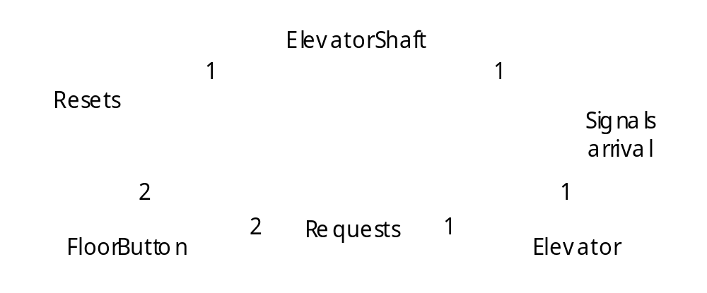
3.8 (Optional Case Study) Thinking About Objects: Identifying the Classes in a Problem Statement
Class associations using UML
  Elided diagram
    Class attributes and operations ignored
    Class relation among ElevatorShaft, Elevator and FloorButton
    Solid line is an association, or relationship between classes
    Numbers near lines express multiplicity values
      Indicate how many objects of class participate association

Slide 54
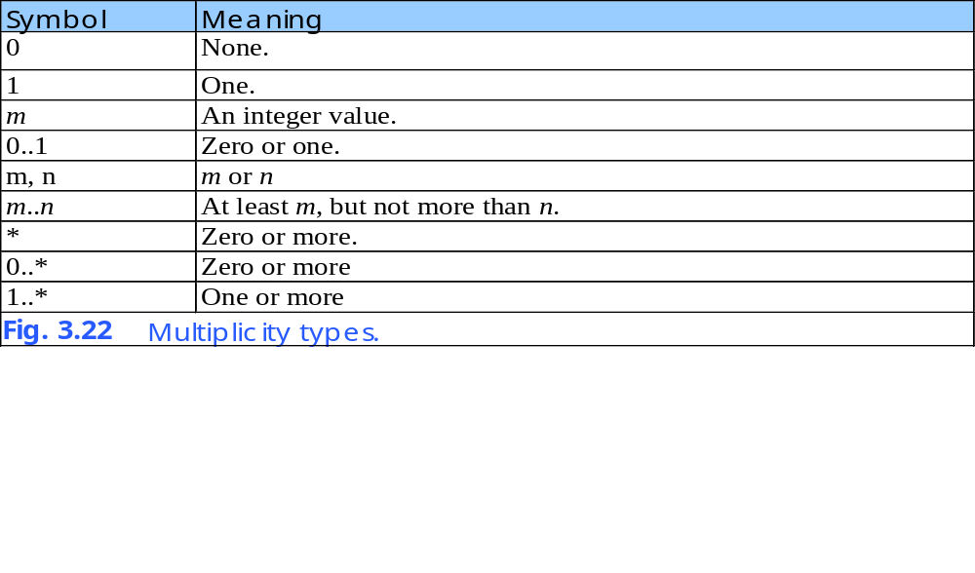
3.8 (Optional Case Study) Thinking About Objects: Identifying the Classes in a Problem Statement
      Diagram shows two objects of class FloorButton participate in association with one object of ElevatorShaft
      FloorButton has two-to-one relationship with ElevatorShaft

Slide 55
3.8 (Optional Case Study) Thinking About Objects: Identifying the Classes in a Problem Statement
  Associations can be named
    In diagram, “Requests” indicates association and arrow indicates direction of association
      One object of FloorButton requests one object of class Elevator
      Similar context with “Resets” and “Signals Arrival”
  Aggregation relationship
    Implies whole/part relationship
      Some object “has” some object
    Object attached with diamond is “owner”
      Object on other end is the “part”
    In diagram, elevator shaft “has an” elevator and two floor buttons

Slide 56
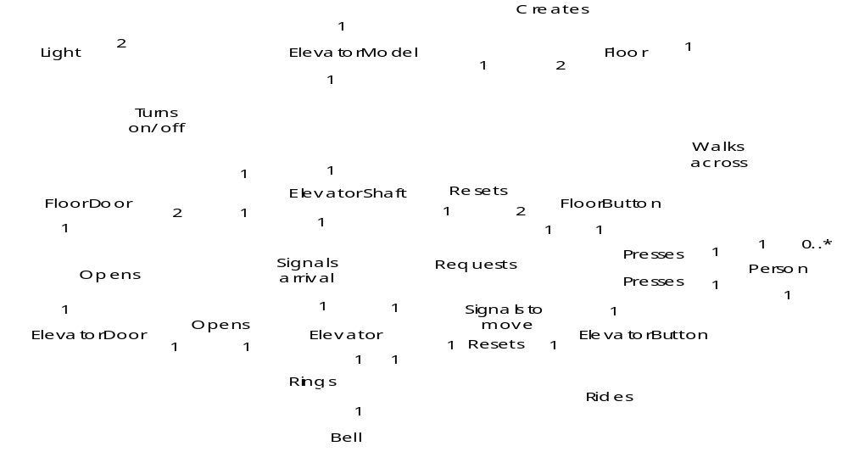
3.8 (Optional Case Study) Thinking About Objects: Identifying the Classes in a Problem Statement
Fig. 3.23 Class diagram for the elevator model.

Slide 57
3.8 (Optional Case Study) Thinking About Objects: Identifying the Classes in a Problem Statement
The complete class diagram for elevator model
  Several of many and aggregates
    ElevatorModel aggregates one ElevatorShaft and two Floor
    Elevator is aggregation of ElevatorDoor, ElevatorButton and Bell
  Several of many associations
    Person “presses” buttons
    Person also “rides” Elevator and “walks” across Floor

Slide 58
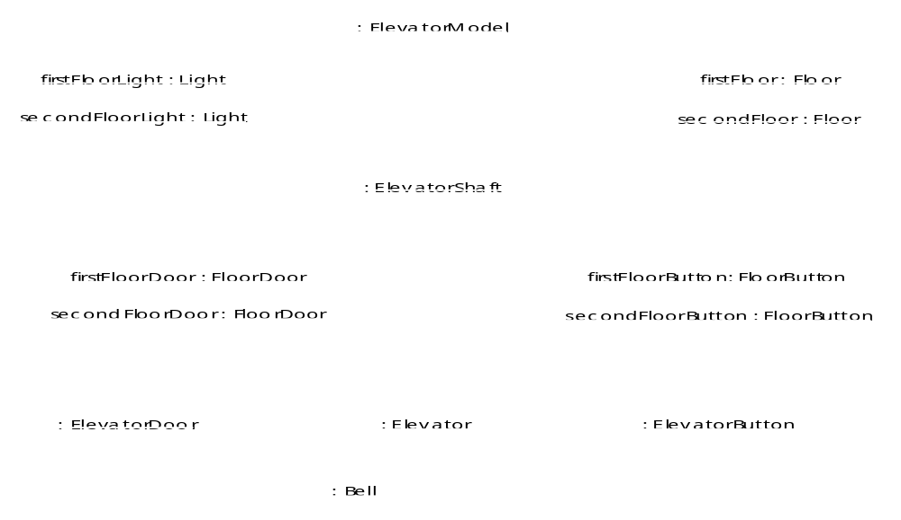
3.8 (Optional Case Study) Thinking About Objects: Identifying the Classes in a Problem Statement
Fig. 3.24 Object diagram of an empty building in our elevator model.

Slide 59
3.8 (Optional Case Study) Thinking About Objects: Identifying the Classes in a Problem Statement
Object diagrams
  Model objects (instances of classes) at a specific time in program execution
  Snapshot of system structure while running
    Information about participation of objects at that time
  Links
    Relationships between objects represented as solid lines
Object diagram when no people in building
  No objects of class Person exist in system at this point
  Objects written in form objectName:ClassName
    UML permits omission of object names instantiated only once
    If object name unknown, just include class name

